Slide 1
Introduction
Thomas Magaldi, M.S., RPh, LMHC
magalditom@gmail.com
Cell: 516 965 1935
FAX: 516 416-4042

Slide 2
Neither the planner(s) or presenter, Thomas Magaldi have any real or perceived vested interest that relate to this presentation that needs to be disclosed.

Slide 3
Objectives for Pharmacist
Identify 3 Symptoms of Burnout.
Describe 3 ways the Pandemic negatively impacted Pharmacy practice.
Discuss the effects of the pandemic on Mental Health of the Pharmacist
4. Explain 3 wellness practices that could aid in the recovery of mental health .

Slide 4
Objectives for Pharmacy Technicians
Describe 3 Symptoms of Burnout.
Describe 3 ways the Pandemic negatively impacted Pharmacy practice.
Discuss the effects of the pandemic on the Mental Health of the Pharmacy Technician
4. Explain 3 lifestyle practices that could aid in the recovery of mental health .

Slide 5
ASHP Statement regarding Burnout in Pharmacists.
Recently, ASHP sent out a notification discussing the importance of the recognition of burnout in the pharmacy profession,
“ Burnout is a threat to patient safety, public health, and the resilience of our healthcare infrastructure. A healthy and thriving pharmacy workforce is essential to ensuring patient safety and optimal medication therapy outcomes”

Slide 6
ACPE Standard Related to Self Awareness (2016)
Standard 4: Personal and Professional Development.
The program imparts to the graduate the knowledge, skills, abilities, behaviors, and attitudes necessary to demonstrate self-awareness, leadership, innovation and entrepreneurship, and professionalism.
Key Elements:
4.1. Self-awareness – The graduate is able to examine and reflect on personal knowledge, skills, abilities, beliefs, biases, motivation, and emotions that could enhance or limit personal and professional growth.

Slide 7
Burnout Definition
Definition The Merriam-Webster Dictionary defines burnout as “exhaustion of physical or emotional strength or motivation, usually as a result of prolonged stress or frustration” .
Many things can cause burnout, but being isolated or feeling unsupported at home or at work can be a major contributors, as can the repetition of facing the same challenges or doing similar tasks over and over.
Burnout is an all encompassing feeling that you are being pulled in every direction at once and that no matter what you do, you are unable to make progress or move forward.
Constant feeling of being at the end of your rope
Physical symptoms: exhausted, fatigued
Emotional-depression, anxiety, etc.

Slide 8
Pharmacists and Burnout before Covid
Pharmacy professionals like other healthcare professionals are prone to burnout due to common risk factors and profession specific factors such as :
Long professional work hours and Increase workload
Inability to meet company specified performance metrics
Staffing shortages
Incompatibility between skills and actual daily tasks
Regulatory requirements.

Slide 9
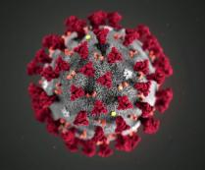
Here comes Coronavirus Sars-2 Covid 19
Thomas Magaldi

Slide 10
Impact of Pandemic New Terminologies
LOCK DOWN
Shelter in Place
Social Distance
Pause
New Norm
Super Spreader
MASK UP
TEST-TEST-TEST
Handwashing

Slide 11
Social Isolation

Slide 12
Impact of the pandemic on the mental health of the general population
Uncertainty and feeling of the lost of control = despair, depression and generalized anxiety with OCD
Reintegrating into a changed world and continue to change our life, ie, loss of socialization, (no touching, social distances) and loss of identity (mask)
Fear of the next pandemic and will we learn from the lessons of previous health crises or will history repeat itself
Loss of freedom – panic attacks
Assume the worse-feeling of doom and hopelessness
Coronaphobia, the fear of contracting Covid or infecting others with it, especially family members.
Coronaphobia evolving into Hypochondria
Covid fatigue: wearing us down, a sense of "I've been dealing with the unknown for so long, it takes more and more energy to maintain that level of hyper-vigilance.
Overwhelmed-deep frustration, “No end in sight” (one variant after another, delta, omnicrom BA1, BA1)
Emotional, Psychological, and spiritual (close house of worships)

Slide 13
Covid Effects on Everyday life

Slide 14
Constant Reminder

Slide 15
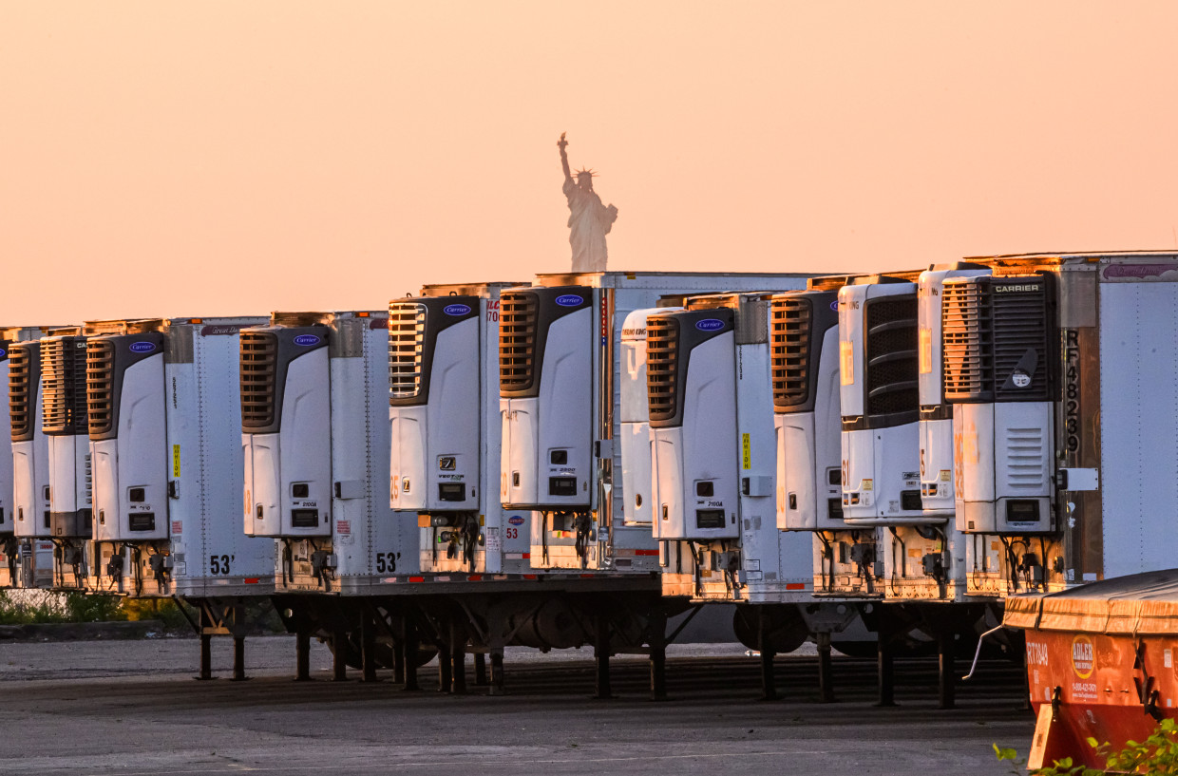
Grim Reminders

Slide 16
Pharmacy Usual stressors
Pharmacists and Pharmacy technicians are under constant stress to perform at a high level and intense pace with no room for error. Attention to detail is a required skill for the pharmacy team because errors could lead to injury or potentially death.
We are behind the scenes that ensure life saving medications are available to the other health care providers when needed.
We are always required to be on the front-lines (Working from home is never an option, such as with storms, etc).
Pharmacy is the most accessible health care provider under constant pressure. (Phones ringing, docusate Stat)
We can become overwhelmed dealing with the demands of the other health care providers.

Slide 17
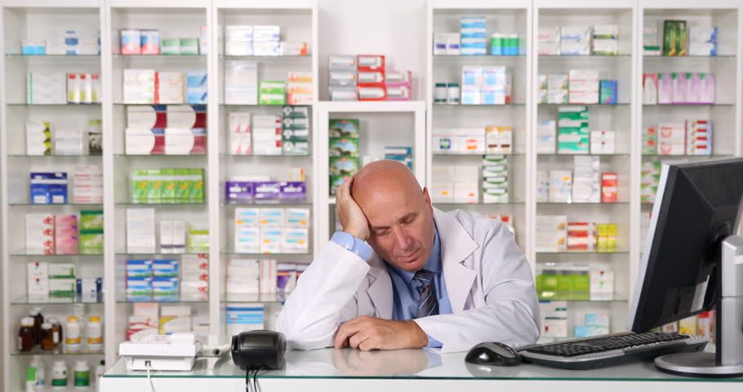
Effects of Pandemic on Mental Health of Pharmacist

Slide 18
Pandemic Impact on Pharmacy’s Scope of Practice
More demanding expectations during covid:
Expansion of Pharmacy Role- provide critical care to an increase numbers of ICU beds and expansion of units.
Staffing-shortages, increased need, staff physically or mentally worn out
Protocol changes - sterile compounding, lack in (PPE) conservative strategies
Operational changes – Staff safety ,infection control concerns , contact precautions , Lack of time for precepting and monitoring new staff

Slide 19
Pandemic Impact on Pharmacy Team
5. Medication Challenges
Medication use Challenges off label use-required guidelines and P/P investigational use and orphan drug status, i.e. reducing the use of nebulized treatments in electronic health record (POE)
Drug Shortages- albuterol inhalers, sedatives and anesthetic agents, neuromuscular blockers, corticosteroids, cardiovascular agents, investigational agents, (miracle drug of the week)
Increased Inventory - great expense to budget which had much uncertainty especially if the medication proved ineffective or fell out of favor

Slide 20
Pandemic Impact on Pharmacy Team
The pandemic changed the dynamics of this relationship! The demands were out of the ordinary stressors (turned up the heat)
While demonstrating an unwavering commitment to serving patients throughout the COVID-19 pandemic, many pharmacists, pharmacy residents, student pharmacists, and pharmacy technicians are experiencing alarming rates of occupational burnout and stress”
Increased demands caused an elevation of levels of stress, fatigue, anxiety, depression (sometimes substance abuse) or other symptoms from the unusual circumstances.
Exhaustion and feeling of depletion with little opportunity or time for self-care especially with lock downs, sheltered in place, pauses, etc.

Slide 21
Pandemic Impact on the Pharmacy Team
The toll of stress was also related to that it wasn’t over quickly, it just kept going with no end or solution in sight, and it eventually wore us down.
Manage our own constant concerns for our health and family’s health despite having to go to our jobs.
Feeling of defeat and hopelessness, ie,“We’re supposed to be the heroes (In Old California).
False assumptions that we can handle this (colleagues in denial-not real)
The constant bombarding of the media of the hopelessness.
Feeling overwhelmed from the constant fear, worry, uncertainty and vigilance of being at risk should have made us to ask/comprehend that we need help. (Did you).

Slide 22
First steps toward recovery: self care!!!...awareness of feelings
The long-term impact of COVID-19 on mental health and well-being is likely to take months before it becomes fully apparent because conditions related to the coronavirus were (and to a certain degree still are) in a constant state of flux.
Therefore, it is imperative that Healthcare providers, including pharmacist and pharmacy technicians be made aware of potential issues with their mental well-being and feelings.
Seek professional help for self-care with no fear of guilt or repercussions

Slide 23
Coping skills
Self Care: meditation, sleep, diet, spirituality,
Exploring other options within our limitations like doing other activities walk, exercise, sports, hobbies, read, etc
POA: awareness/preparation to ground self (know what you’re walking into-visualize it before hand and recognize your realistic role in the situation )
Changed the channel –more to life than CNN or Fox news
Communication with others, have patience and a general level of respect for others and each other feelings (Cooperation/collaboration with team)
Prioritize: Focus on what is in your control, especially when the situation seems out of control.
Resilience

Slide 24
Drag Racing..Dragging my…….

Slide 25
Resilience
Empowerment (handle what we need to do with what we have)
Look at how resilient you are even as hard as it has been. We have gotten through it, or at least to this point (Been there/ done that), ie “I can’t take one more thing, and then there is one more things and people keep on going”
How can we make it better (based on past resources/tools/reference points /accomplishments from our past and present)
Push through and out of our comfort zone (Fight, Flight or Frozen)
Who do you work for (SELF) Believe in self: we determine the definition of the white coat/profession

Slide 26
Resilience

Slide 27
Resilience
Reward self for small accomplishments-celebrate
Explore without expectations.
Be the light/recognize your gifts and talents
One door closes look for the open window
View daily activities as routines rather than as task
Relationships-support networks (can’t do it alone): reach out and touch someone with social media a text, a letter, email, Instagram, etc
Change our perspectives. The art of refocusing gives us ultimate power.

Slide 28
Resilience

Slide 29
Resilience
Develop a purpose “You can handle any How ( create goals,etc) as long as you have a why (Purpose)
Dreams (not fantasy)
Create
Re-invent oneself
Get rid of regrets-turn the corner
Mary Shelley’s -Frankenstein 1818 (1816, the year without a summer - The Eruption of Mount Tambora)
Be productive through action

Slide 30
Action: contribution of Pharmacists
HOPE: Impact of vaccine: Wow, I can’t believe I am here doing this! How can I be holding an authorized vaccine less than a year after the start of the pandemics? Wow, what an opportunity to highlight the important responsibility of pharmacy!
VACCINATION: opportunity for us to be recognized as an important contributor to the solution. Important responsibility we have in healthcare
Education/Information—continue to provide information to the public regarding the accurate and science-based evidence on the vaccines and its effect. People trust us!!
Dispense- PO/IV monoclonal antibodies medications

Slide 31
Hope within our control

Slide 32
Hospice survey: Regrets
Thinking of what other people thought of me/expected of me
Living in the moment
Worrying about things I could not control
Not having or following their dreams

Slide 33
Life Choices

Slide 34
If you feel it’s the end of the world..it is!!!

Slide 35
Which One would you chose

Slide 36
What were pharmacist Identified issues that increased the risk of stress and burnout ?
A) Drug Shortage
B) Decrease PPE
C) Administering rapid test to inpatients
D) both A and B
E) All of the above

Slide 37
Which of the following increased the effect of burnout ?
A) Social Isolation
B) Anxiety
C) Exhaustion
D) Lack of Pharmaceuticals
D.)All of the above

Slide 38
What are some lifestyle choices that can assist in recovery from Burnout ?
Isolate self and sleep more
Enjoy moments spent with family ,friends and colleagues
Run for the hills until the pandemic is over
Change your profession
Ignore feelings and push through it

Slide 39
QUESTIONS
???????

Slide 40
Contact Information
Thomas Magaldi, M.S., RPh, LMHC
magalditom@gmail.com
Cell: 516 965 1935
FAX: 516 416-4042

Slide 41
References
Bray, Bethany. “How (Not) to Isolate during the COVID-19 Pandemic.” Counseling Today, vol. 63, no. 5, Nov. 2020, pp. 34–39.
Bray , Bathany. “The battle against burnout.” Counseling Today , April 2018, pp. 22-29.
Costa, Barry. “The Scoop on Pharmacy Burnout: Description and Management Strategies.” UConn School of Pharmacy, 2 Feb. 2022, pharmacy.uconn.edu/course/scoop-on-burnout.
Esterwood, Emily, and Sy Atezaz Saeed. “Past Epidemics, Natural Disasters, COVID19, and Mental Health: Learning from History as We Deal with the Present and Prepare for the Future.” Psychiatric Quarterly, vol. 91, no. 4, 2020, pp. 1121–33. Crossref, https://doi.org/10.1007/s11126-020-09808-4.
“Mental Health Impact of the Coronavirus Pandemic in New York State.” NYS Health Foundation, Feb. 2021, pp. 1–22.
Meyers, Laurie. “Far Away, so Close: Negoitating Relationships during COVID-19.” Counseling Today, vol. 63, no. 8, Feb. 2021, pp. 24–29.
Pedersen , Craig A, et al. “ASHP National Survey of Phramacy Practice in Hospital Settings : Impact of COVID-19 Pandemic on Pharmacy Operations- 2020.” AJHP, 15 Sept. 2021.
Phillips, Lindsey. “Coping with the (Ongoing) Stress of COVID-19.” Counseling Today, vol. 62, no. 12, June 2020, pp. 26–31.
Phillips , Lindsey. “Putting First Responders' Mental Health on the Front Lines.” Counseling Today , July 2020, pp. 30–35.
Weber, Robert J. “A Day of Relief and Hope.” AJHP, vol. 78, no. 12, June 2021, pp. 1126–33.
“Yale Medicine Magazine Issue View.” Yale School of Medicine, medicine.yale.edu/news/yale-medicine-magazine/issues/2021-issue-167. Accessed 2 Feb. 2022

Slide 42
Special Thanks
My wife Maryann, Varsha, Danny, Shanna, Dr. Diana and Justin

